Slide 1
Asso. Prof. Dong Yabo
dongyb@zju.edu.cn
College of Computer Science and Technology, Zhejiang University

Slide 2
Overview
Memory definitions
Random Access Memory (RAM)
Static RAM (SRAM) integrated circuits
Cells and slices
Cell arrays and coincident selection
Arrays of SRAM integrated circuits
Dynamic RAM (DRAM) integrated circuits
DRAM Types
Synchronous (SDRAM)
Double-Data Rate (DDR SRAM)
RAMBUS DRAM (RDRAM)
Arrays of DRAM integrated circuits

Slide 3
Memory Definitions
Memory ─ A collection of storage cells together with the necessary circuits to transfer information to and from them.
Memory Organization ─ the basic architectural structure of a memory in terms of how data is accessed.
Random Access Memory (RAM) ─ a memory organized such that data can be transferred to or from any cell (or collection of cells) in a time that is not dependent upon the particular cell selected.
Memory Address ─ A vector of bits that identifies a particular memory element (or collection of elements).

Slide 4
Memory Definitions (Continued)
Typical data elements are:
bit ─ a single binary digit
byte ─ a collection of eight bits accessed together
word ─ a collection of binary bits whose size is a typical unit of access for the memory. It is typically a power of two multiple of bytes (e.g., 1 byte, 2 bytes, 4 bytes, 8 bytes, etc.)
Memory Data ─ a bit or a collection of bits to be stored into or accessed from memory cells.
Memory Operations ─ operations on memory data supported by the memory unit. Typically, read and write operations over some data element (bit, byte, word, etc.).

Slide 5
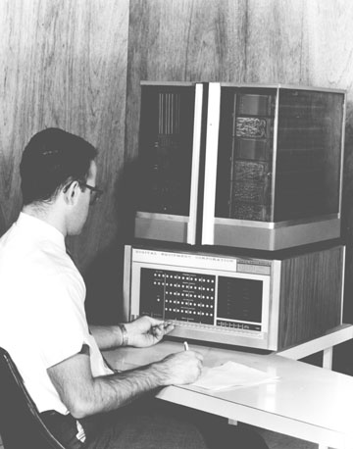
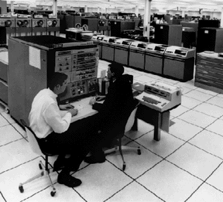
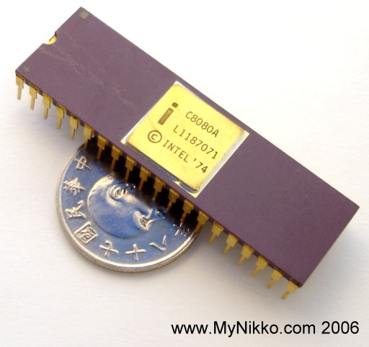
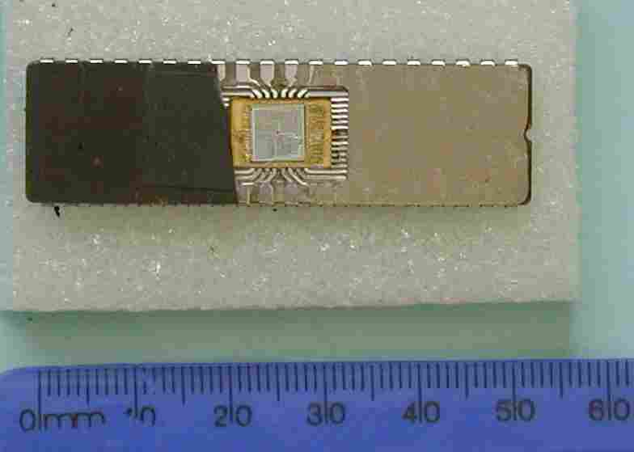
Memory Organization
Intel 8080
Organized as an indexed array of words. Value of the index for each word is the memory address.
Often organized to fit the needs of a particular computer architecture. Some historically significant computer architectures and their associated memory organization:
Digital Equipment Corporation PDP-8 – used a 12-bit address to address 4096 12-bit words.
IBM 360 – used a 24-bit address to address 16,777,216 8-bit bytes, or 4,194,304 32-bit words.
Intel 8080 – (8-bit predecessor to the 8086 and the current Intel processors) used a 16-bit address to address 65,536 8-bit bytes.
PDP-8
IBM 360
Intel 8086
Notes:
PDP-8：1964年生产，是第一台大规模生产的微处理机
Intel 8080：1974年4月，包含6000多个晶体管

Slide 6
Memory Block Diagram
A basic memory system is shown here:
k address lines are decoded to address 2^{k} words of memory.
Each word is n bits.
Read and Write are single control lines defining the simplest of memory operations.
n Data Input Lines
n
k Address Lines
Memory
k
Unit
2^{k} Words
1
n Bits per Word
Read
1
Write
n
n Data Output Lines

Slide 7
Memory Organization Example
Example memory contents:
A memory with 3 address bits & 8 data bits has:
k = 3 and n = 8 so 2³ = 8 addresses labeled 0 to 7.
2³ = 8 words of 8-bit data
Memory Address |  | Memory Content
Binary | Decimal
000 | 0 | 1 0 0 0 1 1 1 1
001 | 1 | 1 1 1 1 1 1 1 1
010 | 2 | 1 0 1 1 0 0 0 1
011 | 3 | 0 0 0 0 0 0 0 0
100 | 4 | 1 0 1 1 1 0 0 1
101 | 5 | 1 0 0 0 0 1 1 0
110 | 6 | 0 0 1 1 0 0 1 1
111 | 7 | 1 1 0 0 1 1 0 0

Slide 8
Basic Memory Operations
Memory operations require the following:
Data ─ data written to, or read from, memory as required by the operation.
Address ─ specifies the memory location to operate on. The address lines carry this information into the memory. Typically: n bits specify locations of 2^{n} words.
An operation ─ Information sent to the memory and interpreted as control information which specifies the type of operation to be performed. Typical operations are READ and WRITE. Others are READ followed by WRITE and a variety of operations associated with delivering blocks of data. Operation signals may also specify timing info.

Slide 9
Basic Memory Operations (continued)
Read Memory ─ an operation that reads a data value stored in memory:
Place a valid address on the address lines.
Toggle the memory read control line.
Wait for the read data to become stable.
Write Memory ─ an operation that writes a data value to memory:
Place a valid address on the address lines and valid data on the data lines.
Toggle the memory write control line.
Sometimes the read or write enable line is defined as a clock with precise timing information (e.g. Read Clock, Write Strobe).
Otherwise, it is just an interface signal.
Sometimes memory must acknowledge that it has completed the operation.

Slide 10
Memory Operation Timing
Most basic memories are asynchronous
Storage in latches or storage of electrical charge
No clock
Controlled by control inputs and address
Timing of signal changes and data observation is critical to the operation
Read timing:
20 ns
Clock
T1
T2
T3
T4
T1
Address
Address valid
Memory
enable
Read/
Write
Data
Data valid
output
65 ns
Read cycle 读取延迟

Slide 11
Memory Operation Timing
Write timing:
Critical times measured with respect to edges of write pulse (1-0-1):
Address must be established at least a specified time before 1-0 and held for at least a specified time after 0-1 to avoid disturbing stored contents of other addresses
Data must be established at least a specified time before 0-1 and held for at least a specified time after 0-1 to write correctly
20 ns
Clock
T1
T2
T3
T4
T1
Address
Address valid
Memory
enable
Read/
Write
Data
Data valid
input
75 ns
Write cycle
Notes:
CPU控制Read/Write
CPU提供数据到Data input
Read/Write拉高表示读取完成，Data在input上多保持一会，防止没读上

Slide 12
RAM Integrated Circuits
Types of random access memory
Static – information stored in latches
Dynamic – information stored as electrical charges on capacitors
Charge “leaks” off
Periodic refresh of charge required
Dependence on Power Supply
Volatile – loses stored information when power turned off
Non-volatile – retains information when power turned off
Notes:
SRAM静态存储器，信息保持在Latch中，每一位对应一套Latch
优点是由于Latch用门存储，所以速度快，但是一个bit存储需要8个以上晶体管，成本较大，存储密度低，集成度低，面积大
DRAM使用电容存储，但是一段时间后电容放电会导致数据消失，所以需要定时刷新
集成密度高，成本低

Slide 13
Static RAM － Cell
Array of storage cells used to implement static RAM
Storage Cell
SR Latch
Select input for control
Dual Rail Data Inputs B and B
Dual Rail Data Outputs C and C
Select
B
S
Q
C
C
B
R
Q
RAM cell

Slide 14
Static RAM － Bit Slice
Represents all circuitry that is required for 2^{n} 1-bit words
Multiple RAM cells
Control Lines:
Word select i – one for each word
Bit Select
Data Lines:
Data in
Data out
W
ord
Select
select
0
B
S
Q
X
C
B
R
Q
X
C
W
ord
RAM cell
select
0
RAM cell
W
ord
select
1
RAM cell
W
ord
Select
select
2
n
-
1
S
Q
X
W
ord
select
2
n
-
1
R
Q
X
RAM cell
RAM cell
Read/Write
logic
Q
Data in
Data out
Data in
S
Read/
Bit
R
Q
Write
select
(b) Symbol
Write logic
Read logic
Data out
Read/
Bit
Write
select
(a) Logic diagram
Notes:
Read/Write 为0是写入，为1是读取
在任何时刻最多只有一个word select是1，其他都是0，需要使用decoder来控制word select

Slide 15
2^{n}-Word × 1-Bit RAM IC
To build a RAM IC from a RAM slice, we need:
Decoder － decodes the n address lines to 2^{n} word select lines
A 3-state buffer on the data output permits RAM ICs to be combined into a RAM with c × 2^{n} words
4-to-16
0
Word select
Decoder
A
3
A
3
2
3
1
2
RAM cell
A
2
A
2
2
2
3
4
A
1
A
1
2
1
5
6
RAM cel
l
A
0
A
0
2
0
7
16 x
1
8
RAM
9
10
Data
Data
11
input
output
12
13
14
Read/
15
Write
Memory
RAM cell
enable
(a) Symbol
Read/Write
logic
Data input
Data in
Data
Data out
output
Read/
Bit
Write
select
Read/Write
Chip select
(b) Block diagram

Slide 16
Cell Arrays and Coincident Selection
Memory arrays can be very large =>
Large decoders
Large fanouts for the bit lines
The decoder size and fanouts can be reduced by approximately by using a coincident selection in a 2-dimensional array
Uses two decoders, one for words and one for bits
Word select becomes Row select
Bit select becomes Column select
See next slide for example
A₃ and A₂ used for Row select
A₁ and A₀ for Column select

Slide 17
Cell Arrays and Coincident Selection (continued)
Row decoder
2-to-4
Decoder
0
A
3
2
1
RAM cell
RAM cell
RAM cell
RAM cell
A
2
2
0
0
1
2
3
1
Row
RAM cell
RAM cell
RAM cell
RAM cell
select
4
5
6
7
2
RAM cell
RAM cell
RAM cell
RAM cell
8
9
10
11
3
RAM cell
RAM cell
RAM cell
RAM cell
12
13
14
15
Read/Write
Read/Write
Read/Write
Read/Write
logic
logic
logic
logic
Data in
Data in
Data in
Data in
Data out
Data out
Data out
Data out
Read/
Bit
Read/
Bit
Read/
Bit
Read/
Bit
Write
select
Write
select
Write
select
Write
select
Data input
Read/Write
X
X
X
X
Column select
Data
0
1
2
3
output
Column
2-to-4 Decoder
decoder
with enable
2
1
2
0
Enable
A
1
A
0
Chip select
Notes:
高位 A2 A3 行地址，低位列地址
A0 A1 A2 A3 = 1001 对应RAM cell9
同样任何时候只有一个位片是被是能的
这是16*1

Slide 18
RAM ICs with > 1 Bit/Word
Word length can be quite high.
To better balance the number of words and word length, use ICs with > 1 bit/word
See Figure in next slide for example
2 Data input bits
2 Data output bits
Row select selects 4 rows
Column select selects 2 pairs of columns

Slide 19
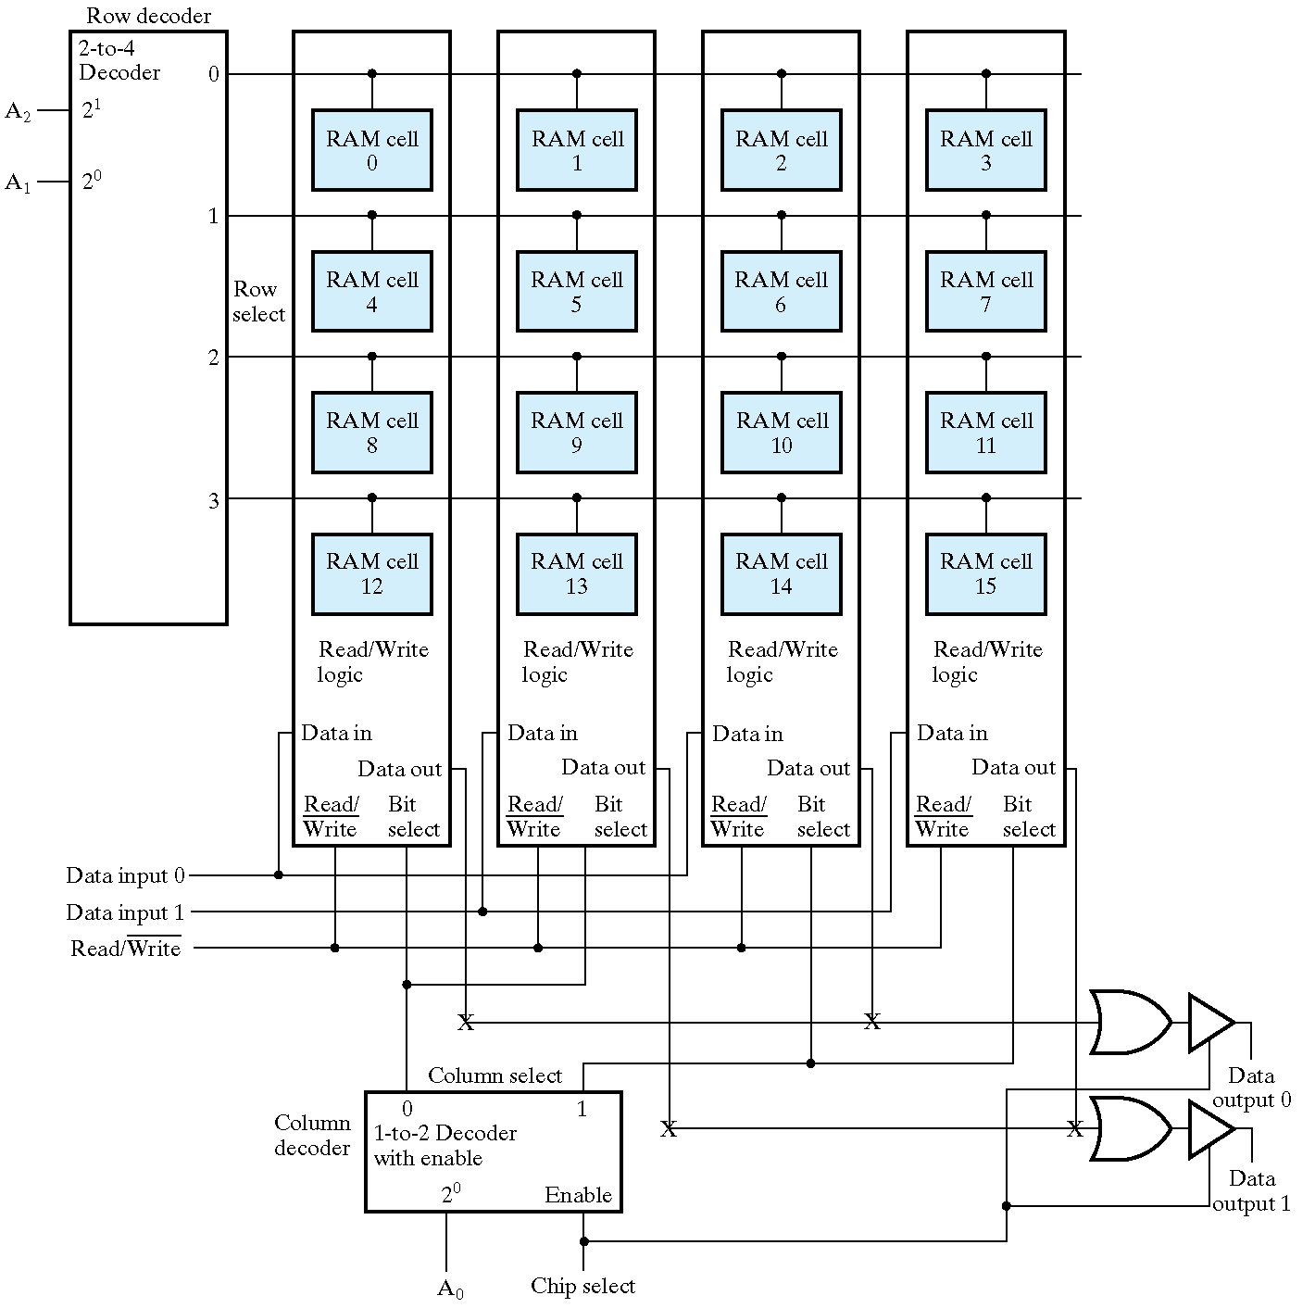
8×2RAM
Notes:
由两个位片组成一个字
蓝线低位绿线高位

Slide 20
Making Larger Memories
Using the CS lines, we can make larger memories from smaller ones by tying all address, data, and R/W lines in parallel, and using the decoded higher order address bits to control CS.
Using the 4-Word by 1-Bit memory from before, we construct a 16-Word by 1-Bit memory. ⇒
Notes:
每个小芯片有A0 A1两个地址线，是4 * N的芯片，四个连一起形成16*N芯片
A0 A1 A2 A3 = 1001，从上到下第二个芯片被使能，内部的01号地址被使能，此处存储的数据被输出
没有被使能的芯片输出是高阻态，所以Data out被接在一起

Slide 21
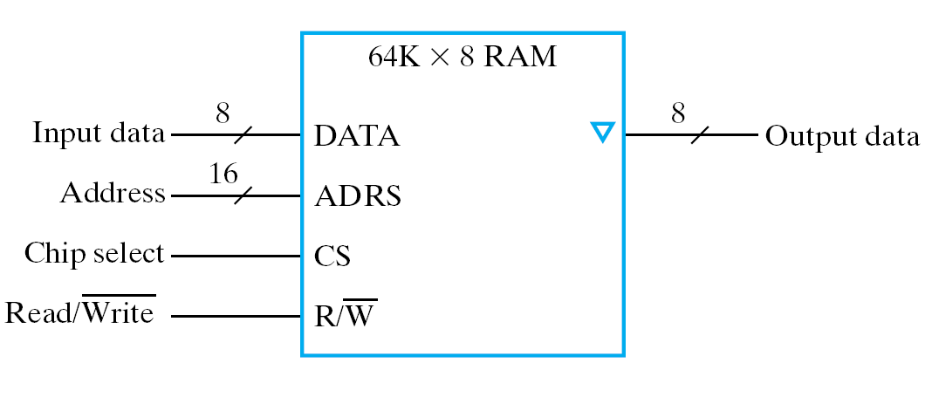
64K×8RAM

Slide 22
Using 64K×8RAM construct 256K×8RAM

Slide 23
Making Wider Memories
To construct wider memories from narrow ones, we tie the address and control lines in parallel and keep the data lines separate.
For example, to make a 4-word by 4-bit memory from 4, 4-word by 1-bit memories ⇒
Note: Both 16x1 and 4x4 memories take 4-chips and hold 16 bits of data.

Slide 24
Using 64K×8RAM construct 64K×16RAM
Notes:
一个芯片输出当高字节，一个当低字节

Slide 25
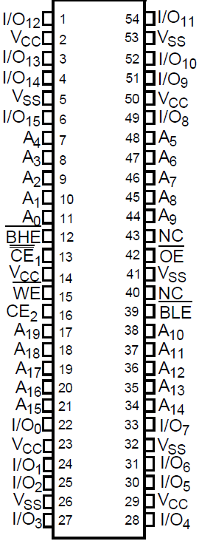
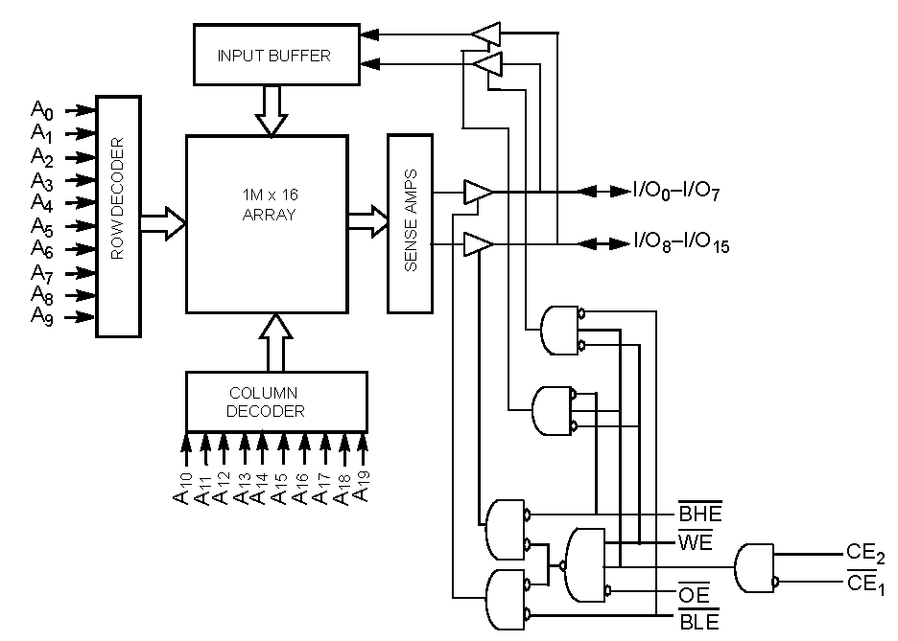
SRAM For SWORD：CY7C1061DV33
16-Mbit(1M×16) Static
Word=16bit
2²⁰=1M WORD
Notes:
3片，1M×16b
SWORD-V2版(紫金港)：BHE/BLE、OE、WE、CE1/CE2信号三个芯片6Byte同时控制。影响写操作，需读回写。
SWORD-V4版(玉泉)：BHE/BLE、OE、WE、CE1/CE2信号3个芯片6B可分别控制。可分别写。

Slide 26
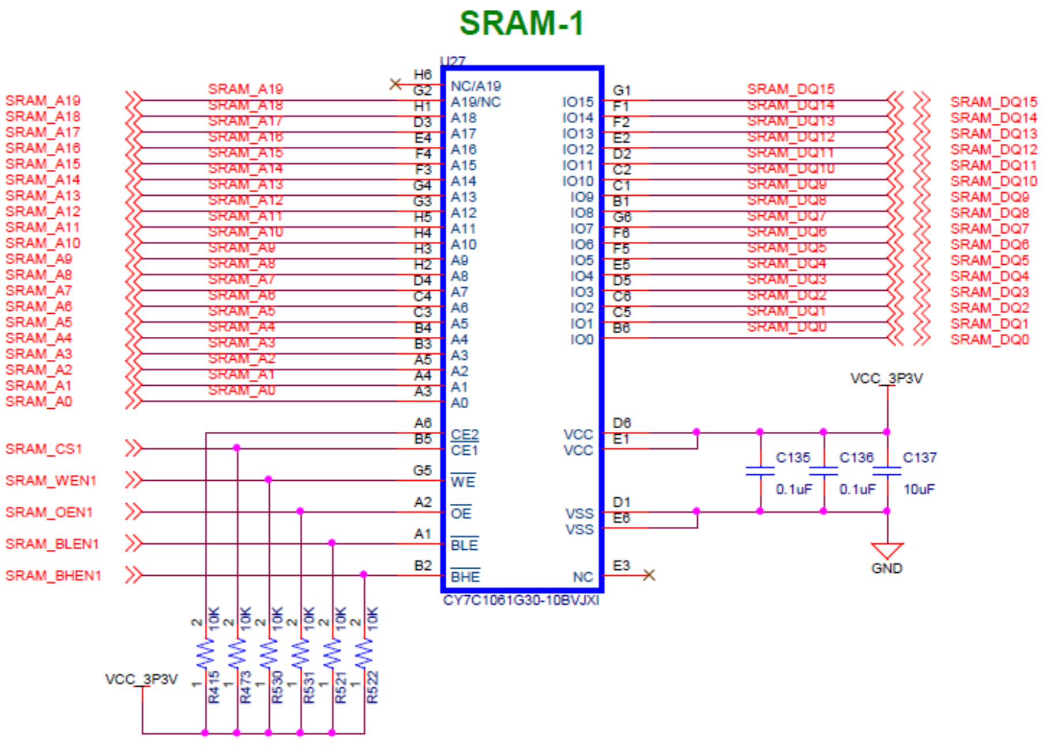
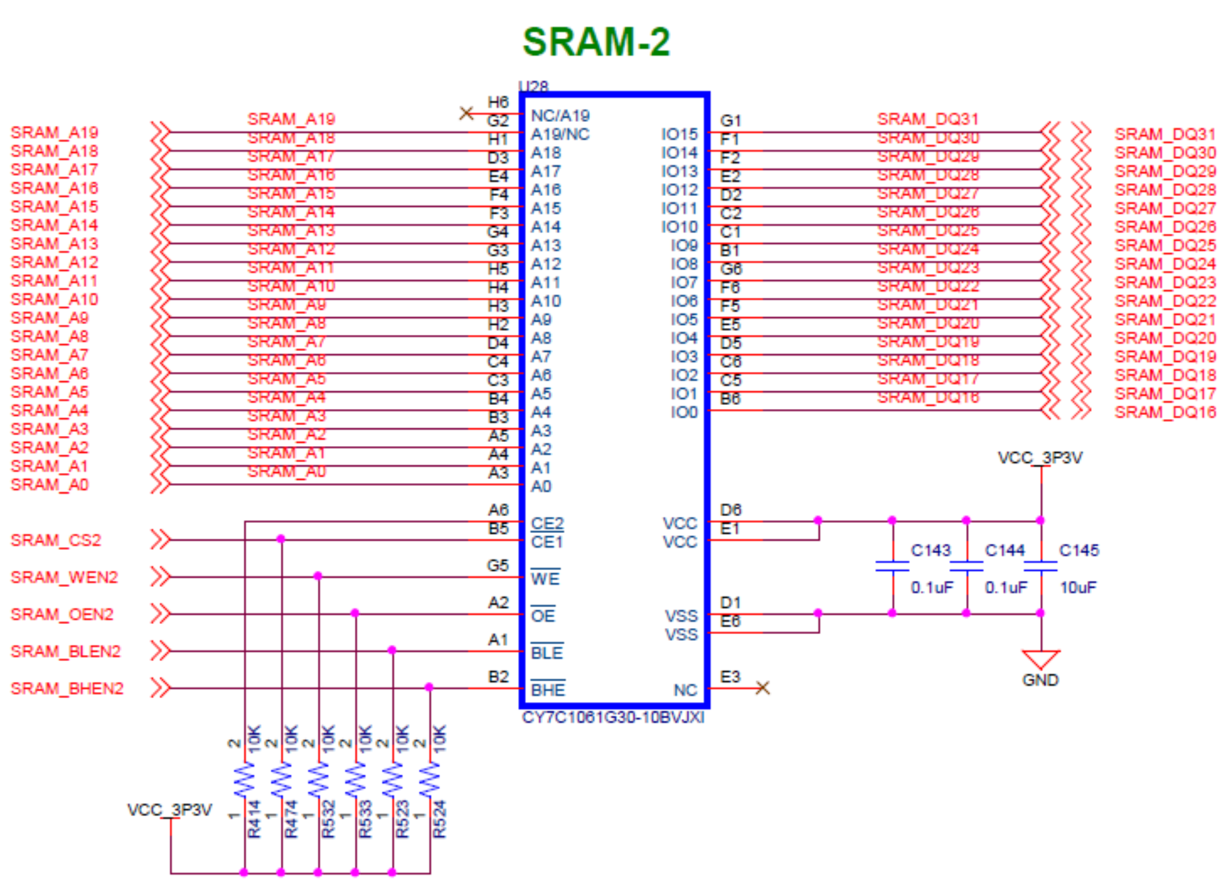
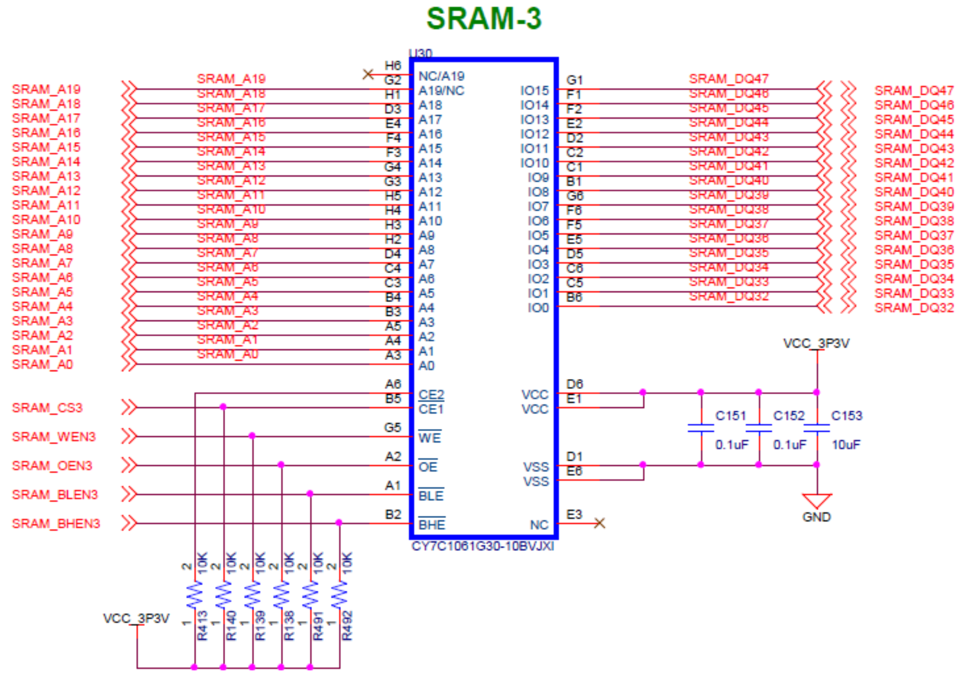
SWORD Onboard memory-SRAM
Memory Organization：
CY7C1061DV33×3 for 1M×48bit(6MB)

Slide 27
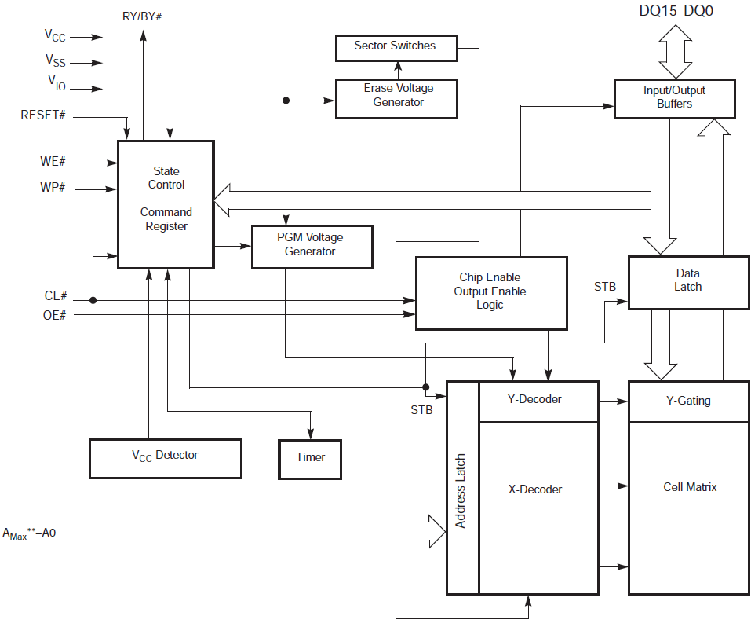
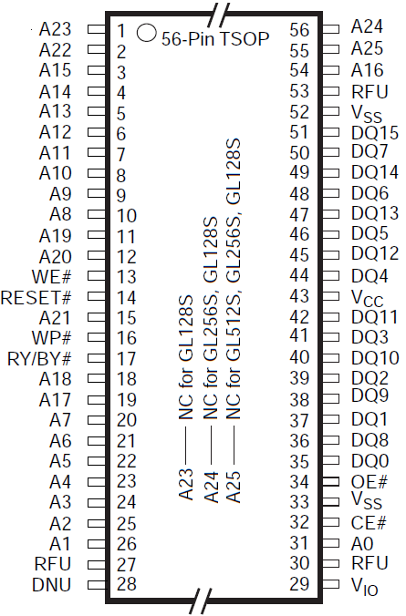
Other Memory for SWORD-NOR Flash
128 Mbit
8M*16bit
Word = 16bit
2²³=8M Word
A22 ~ A0
S29GL128S10TFI010

Slide 28
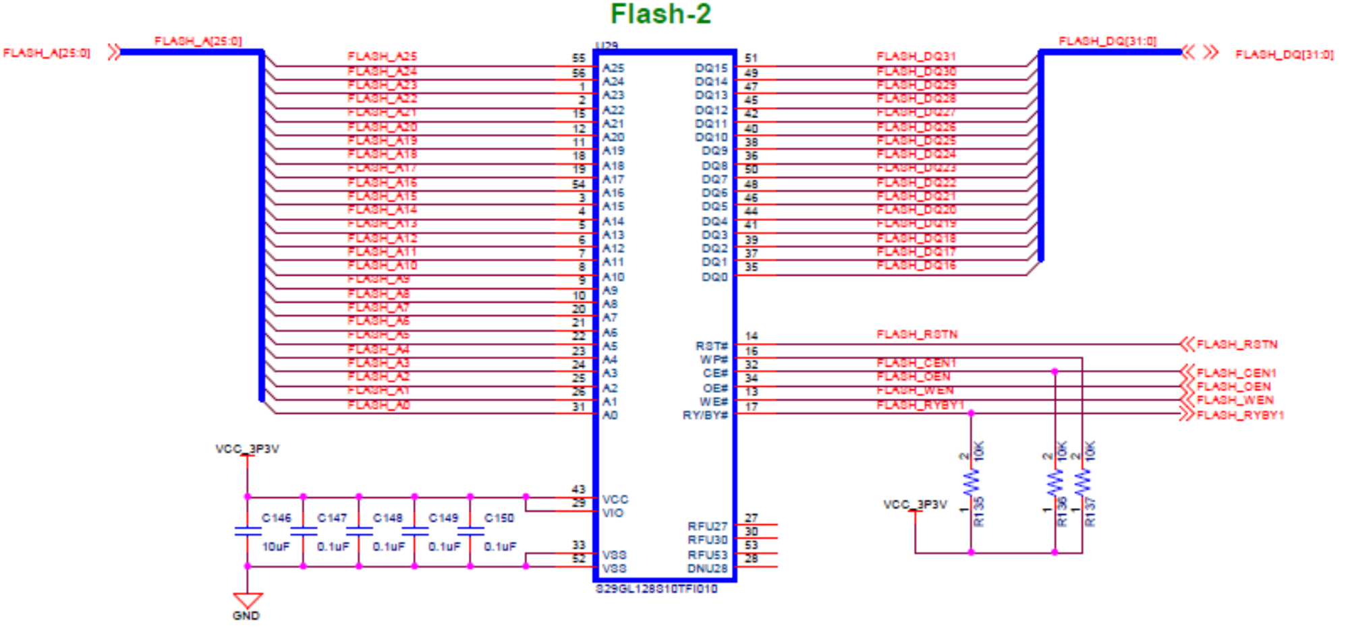
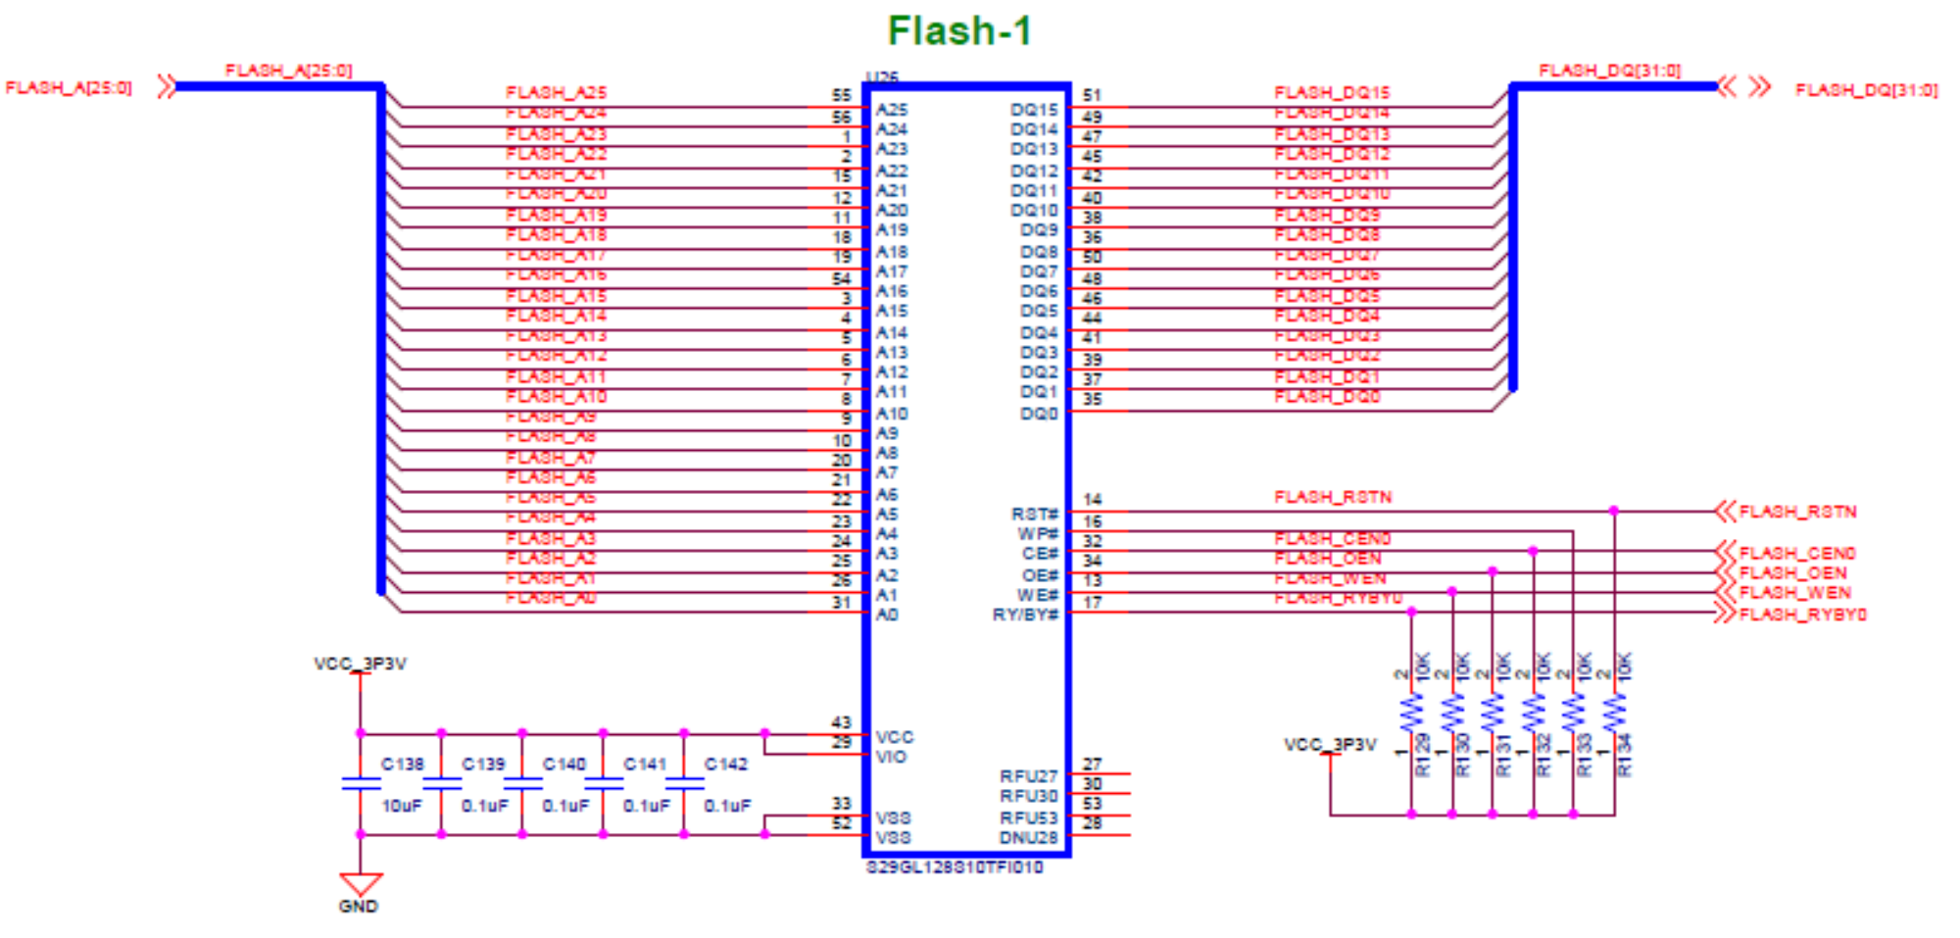
SWORD Onboard memory-NOR Flash
Memory Organization：
S29GL128S10TFI010×2 for 8M×32bit(32MB)
读写时序不同请查阅手册

Slide 29
Dynamic RAM (DRAM)
Basic Principle: Storage of information on capacitors.
Charge and discharge of capacitor to change stored value
Use of transistor as “switch” to:
Store charge
Charge or discharge
See next slide for circuit, hydraulic analogy, and logical model.

Slide 30
Dynamic RAM (continued)
Select
Stored 1
Stored 0
T
To Pump
B
C
DRAM cell
(a)
(b)
(c)
Write 1
Write 0
Select
D
(d)
(e)
B
Q
C
Read 1
Read 0
C
DRAM cell
model
(h)
(f)
(g)
Notes:
Warning: (d), (e), (f), and (g) are animated. Each animation is triggered with a mouse click
and goes through two steps at 1 second intervals.
左边是大电容，右边是小电容，若干小电容接在一个大电容，晶体管式开关

Slide 31
Dynamic RAM - Bit Slice
C is driven by 3-state drivers
Sense amplifier is used to change the small voltage change on C into H or L
In the electronics, B, C, and the sense amplifier output are connected to make destructive read into non-destructive read
W
ord
Select
select
0
B
D
Q
C
C
DRAM cell
W
ord
model
select
0
DRAM cell
W
ord
select
1
Word
Select
DRAM cell
select
2^{n} -1
D
Q
Word
select
C
DRAM cell
2^{n} -1
model
DRAM cell
Read/Write
logic
Sense
Data in
Data out
Data in
amplifier
Read/
Bit
Write
select
(b) Symbol
Write logic
Read logic
Data out
Read/
Bit
Write
select
(a) Logic diagram

Slide 32
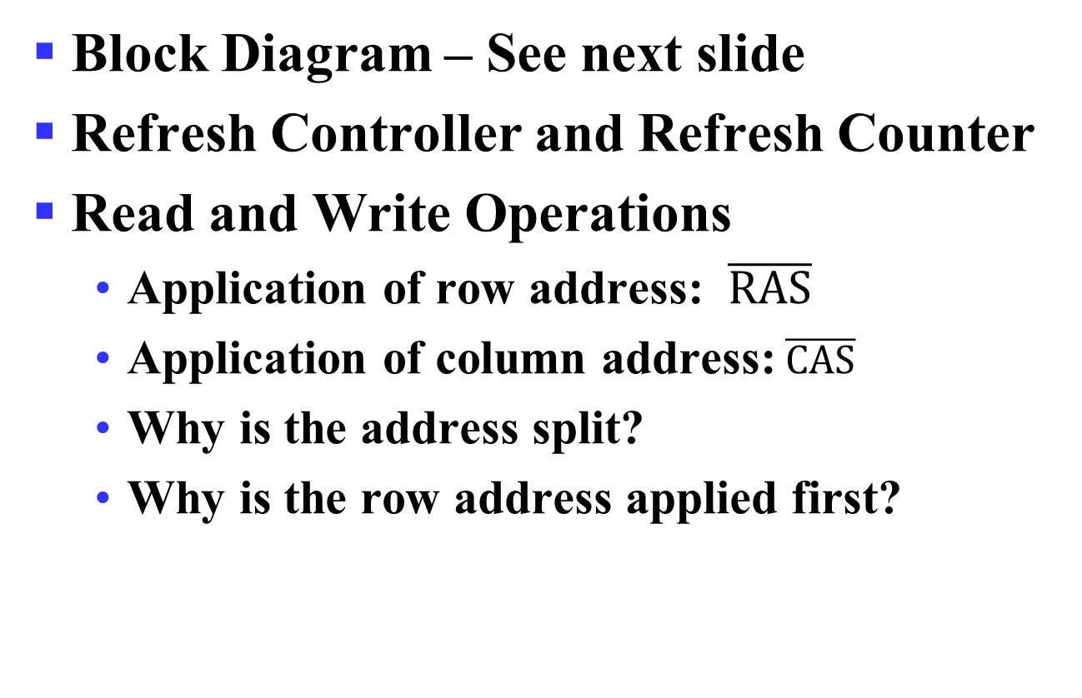
Dynamic RAM - Block Diagram
Block Diagram – See next slide
Refresh Controller and Refresh Counter
Read and Write Operations
Application of row address: $\overline{RAS}$
Application of column address:$\overline{CAS}$
Why is the address split?
Why is the row address applied first?
Notes:
The address is split to roughly halve the large number of address pins on the typical RAM IC.
The row address is used to select the row of cells to be read within the memory.
The column address is used to select the word to be placed on the output from the data read
from the row of cells. Since the data must be read from the cells before it can be selected, the
row address must be applied first.
DRAM的储存量很大因此输入引脚比较多，需要分两次来送地址，先行后列

Slide 33
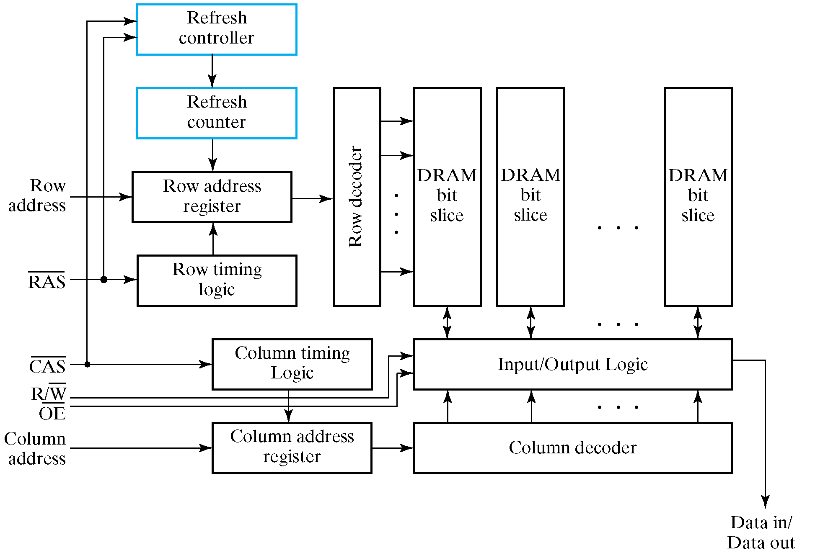
Dynamic RAM - Block Diagram
Notes:
The address is split to roughly halve the large number of address pins on the typical RAM IC.
The row address is used to select the row of cells to be read within the memory.
The column address is used to select the word to be placed on the output from the data read
from the row of cells. Since the data must be read from the cells before it can be selected, the
row address must be applied first.

Slide 34
Dynamic RAM Read Timing
20 ns
Clock
T1
T2
T3
T4
T1
Address
Row
Column
Address
Address
RAS
CAS
Output
enable
Read/
Write
Data
Hi-Z
Data valid
output
65 ns
Read cycle
Notes:
CPU先提供行地址，RAS标记为下降沿，再送过去一个列地址，CAS为下降沿】
行地址是个寄存器，列地址是个计数器

Slide 35
Dynamic RAM Write Timing
20 ns
Clock
T1
T2
T3
T4
T1
Address
Row
Column
Address
Address
RAS
CAS
Output
enable
Read/
Write
Data
Data valid
input
75 ns
Write cycle

Slide 36
DRAM Types
Types to be discussed
Synchronous DRAM (SDRAM)
Double Data Rate SDRAM (DDR SDRAM)
RAMBUS® DRAM (RDRAM)
Justification for effectiveness of these types
DRAM often used as a part of a memory hierarchy (Detail discussed in Computer Architecture)
Reads from DRAM bring data into lower levels of the hierarchy
Transfers from DRAM involve multiple consecutively addressed words
Many words are internally read within the DRAM ICs using a single row address and captured within the memory
This read involves a fairly long delay
Notes:
DDR在时钟的上升沿和下降沿都可以进行操作

Slide 37
DRAM Types (continued)
Justification for effectiveness of these types (continued)
These words are then transferred out over the memory data bus using a series of clocked transfers
These transfers have a low delay, so several can be done in a short time
The column address is captured and used by a synchronous counter within the DRAM to provide consecutive column addresses for the transfers
burst read – the resulting multiple word read from consecutive addresses

Slide 38
Synchronous DRAM
Transfers to and from the DRAM are synchronize with a clock
Synchronous registers appear on:
Address input
Data input
Data output
Column address counter
for addressing internal data to be transferred on each clock cycle
beginning with the column address counts up to column address + burst size – 1

Slide 39
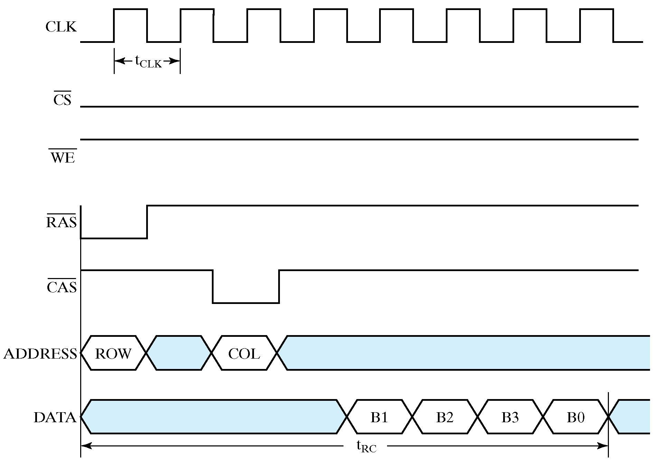
Synchronous DRAM - burst size=4

Slide 40
Synchronous DRAM
Example: Memory data path width: 1 word = 4 bytes Burst size: 8 words = 32 bytes Memory clock frequency: 5 ns Latency time (from application of row address until first word available): 4 clock cycles Read cycle time: (4 + 8) x 5 ns = 60 ns Memory Bandwidth: 32/(60 x 10⁻⁹) = 533 Mbytes/sec

Slide 41
Double Data Rate Synchronous DRAM
Transfers data on both edges of the clock
Provides a transfer rate of 2 data words per clock cycle
Example: Same as for synchronous DRAM
Read cycle time = 60 ns
Memory Bandwidth: (2 x 32)/(60 x 10⁻⁹) = 1.066 Gbytes/sec

Slide 42
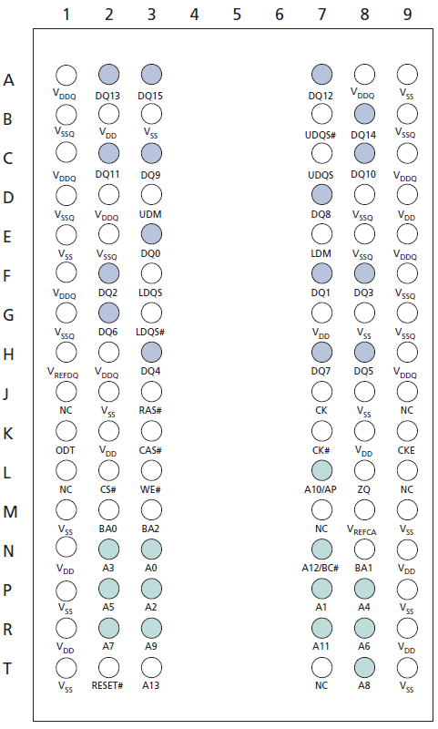
DDR3 For SWORD：MT41J128M16JT
Package：96-Ball FBGA
MT41J128M16

Slide 43
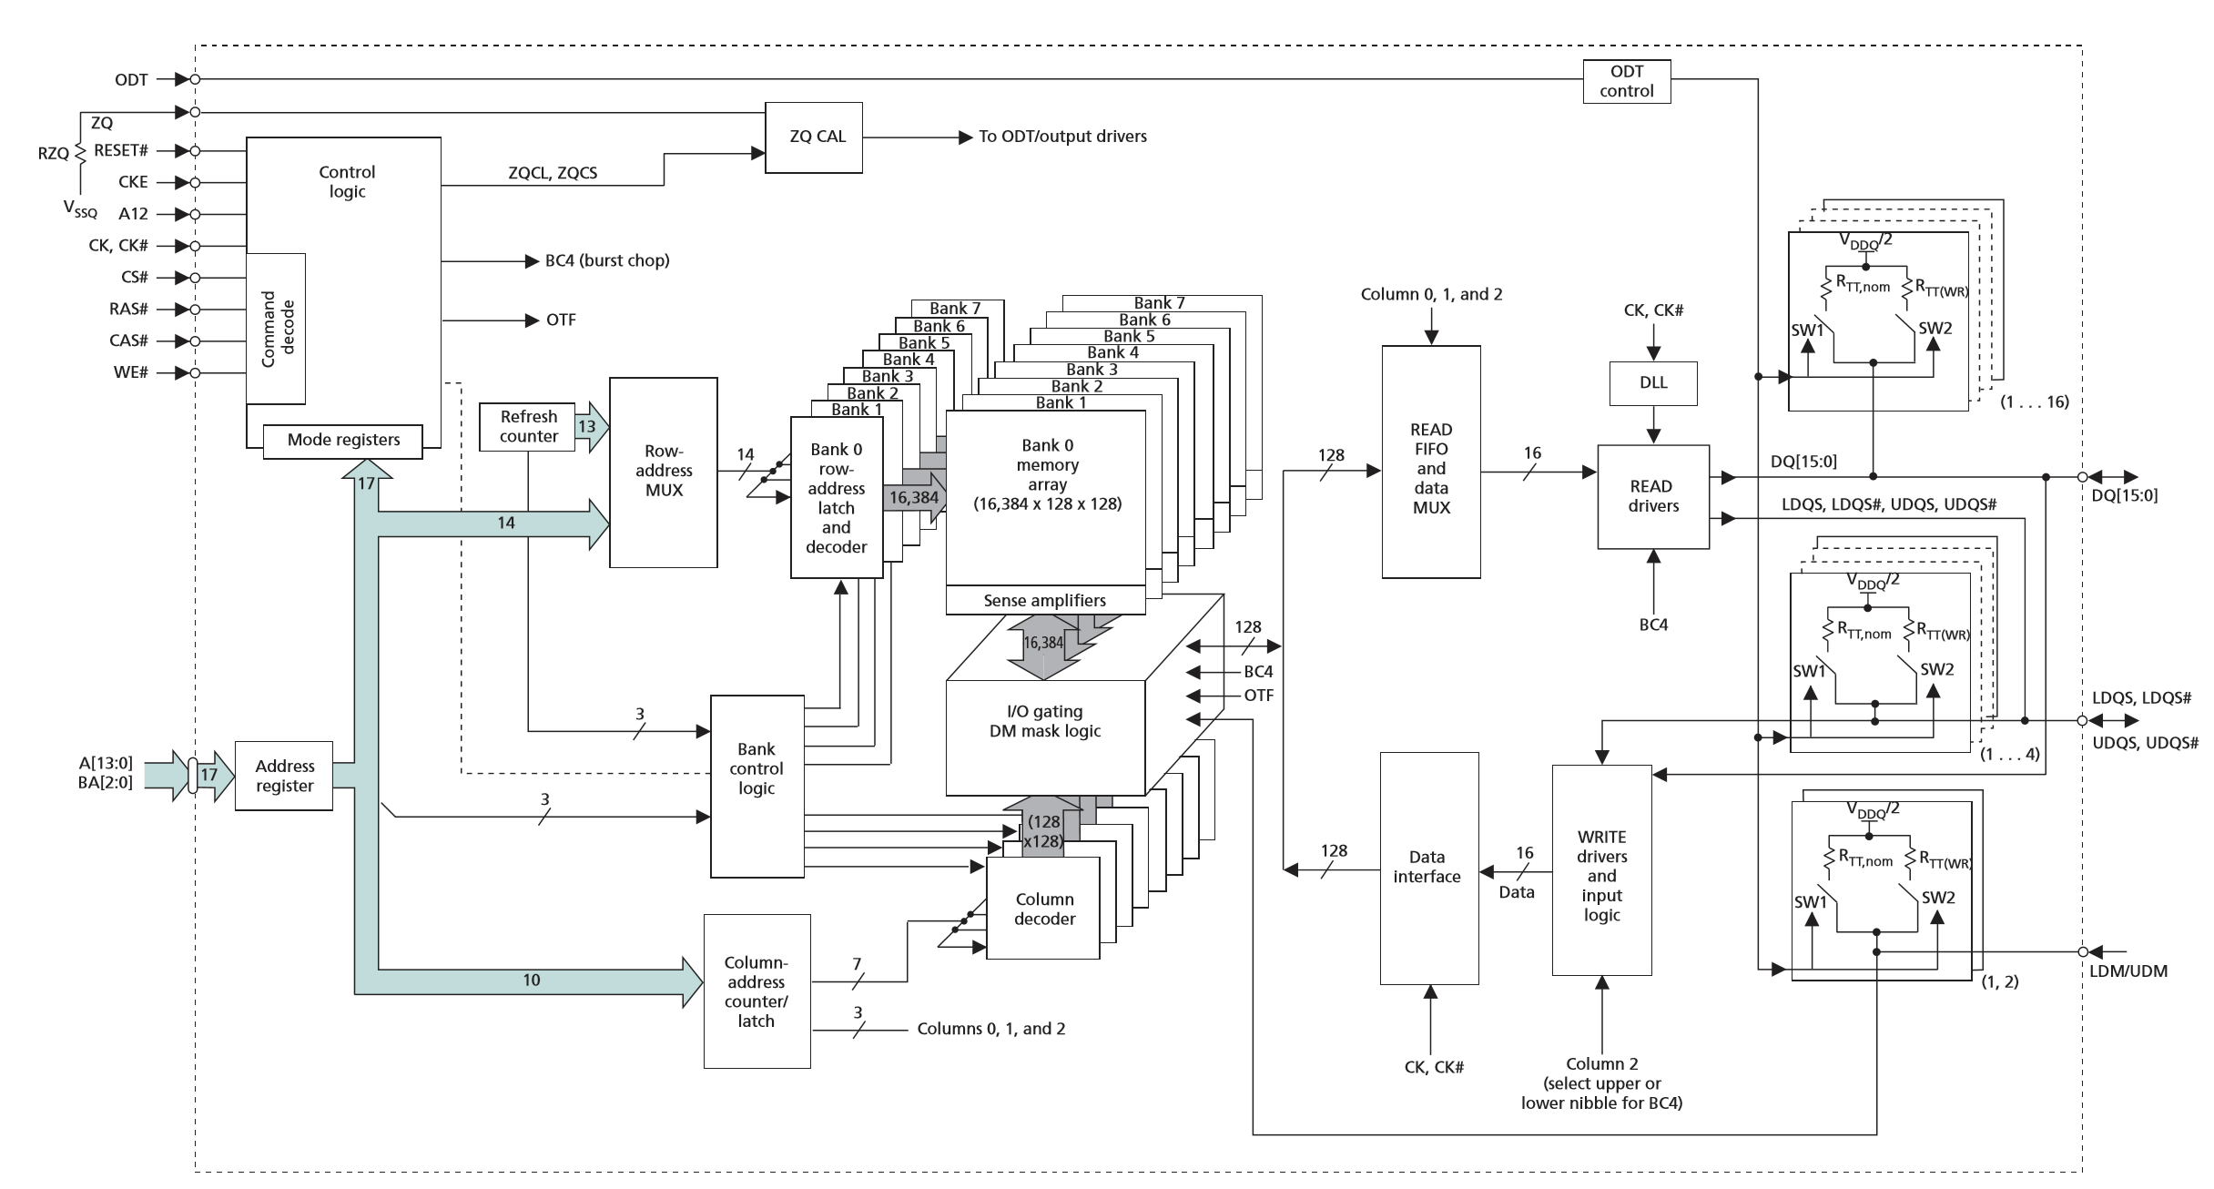
DDR3 For SWORD：MT41J128M16JT
2³BANK
2³
Word=16bit
2¹⁴=16384
2⁷=2³×2⁴
=2⁴
A₁₃~A₀
128×128=2⁷×2⁷
2¹⁴=row
17位
128/2⁷Column
BA₂~BA₀
2²⁷=128M Word
A₉~A₀
2³¹(128M×16bit=2²⁷⁺⁴bit)memory Cell，8 BANK，there are 17 address line
Notes:
2³¹(128M×16bit=2²⁷⁺⁴bit)个存储单元(Cell)，分成8个BANK，共有17根地址线。地址线作为行地址输入时分为二组，其中A₁₃~A₀控制行阵列选择(8个128×128二维单元)和BA₂~BA₀控制BANK选择，由RAS控制信号锁存；地址线作为列地址时只用了10根列地址线(A₉~A₀)，也分为二组，由CAS信号控制锁存)。
每一个BANK由16384(2¹⁴)个128×128的二维Cell阵列构成，由14根行地址线A₁₃~A₀选择，形成由2²⁸个Cell组成的三维立体阵列（16384×128×128），共有8个三维立体阵列(BANK)，由行地址线BA₂~BA₀选择，芯片内部阵列总计2³¹个Cell。
行地址A₁₃~A₀每次选中所有BANK中的一个二维Cell阵列(128×128)，并由BA₂~BA₀选用其中的一个128×128Cell阵列。选中的二维阵列由列地址A₉~A₃选中其中的一列(128Cell)，与FIFO读缓冲器或数据接口模块连接。若是读操作，读出到FIFO读缓冲器，再由列地址A₂~A₀控制每次输出16位；若是写操作，从128位输入接口模块选择16位写入。

Slide 44
MT41J128M16JT Logical Structure
2³¹(128M×16bit=2²⁷⁺⁴bit)个存储单元(Cell)，分成8个BANK，共有17根地址线。
地址线作为行地址输入时分为二组，其中A₁₃~A₀控制行阵列选择，BA₂~BA₀控制BANK选择，由RAS控制信号锁存；地址线作为列地址时只用了10根列地址线(A₉~A₀)，也分为二组，由CAS信号控制锁存。
每一个BANK是由2²⁸个Cell组成的三维立体阵列16384(2¹⁴)×128×128，共有8个三维立体阵列(BANK)，芯片内部阵列总计2³¹个Cell。
行地址A₁₃~A₀每次选中所有BANK中的一个128×128Cell阵列，并由BA₂~BA₀选用某个BANK的一个128×128Cell阵列。
选中的128×128Cell阵列由列地址A₉~A₃选中其中的一列(128Cell)，与FIFO读缓冲器或数据接口模块连接。若是读操作，读出到FIFO读缓冲器，再由列地址A₂~A₀控制每次输出16位；若是写操作，从128位输入接口模块选择16位写入。

Slide 45
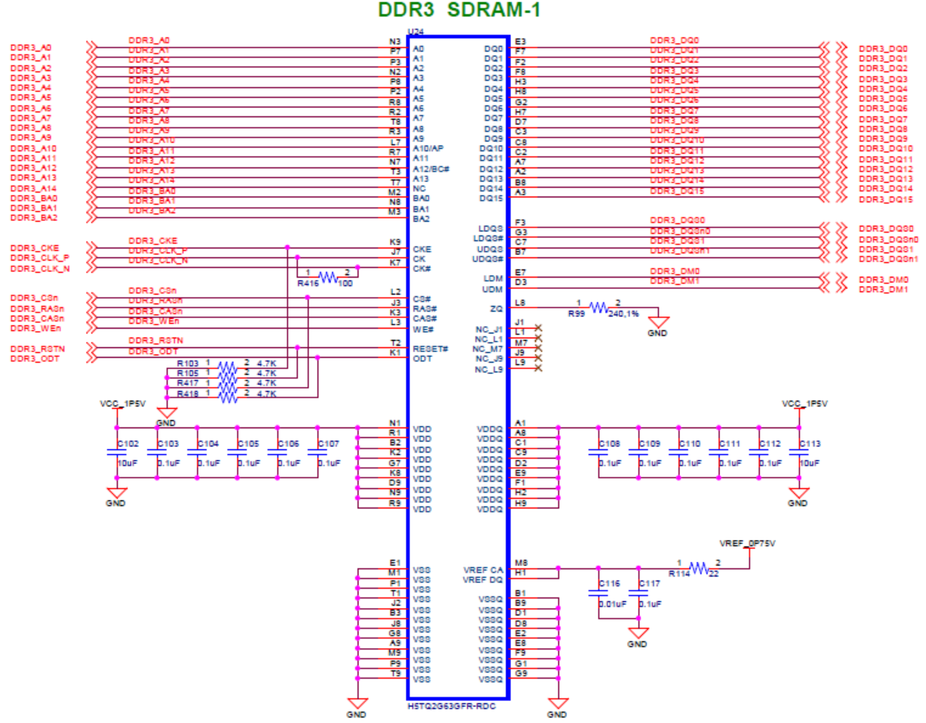
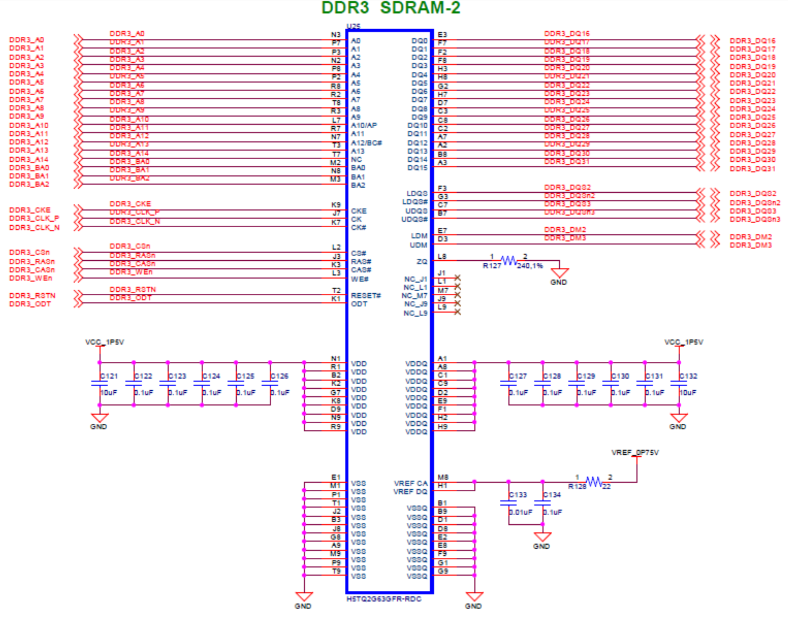
SWORD Onboard memory-DDR3
Memory Organization
MT41J128M16JT×2 for 128M×32bit(512MB)
读写时序更复杂请查阅手册

Slide 46
RAMBUS DRAM (RDRAM)
Uses a packet-based bus for interaction between the RDRAM ICs and the memory bus to the processor
The bus consists of:
A 3-bit row address bus
A 5-bit column address bus
A 16 or 18-bit (for error correction) data bus
The bus is synchronous and transfers on both edges of the clock
Packets are 4-clock cycles long giving 8 transfers per packet representing:
A 12-bit row address packet
A 20-bit column address packet
A 128 or 144-bit data packet
Multiple memory banks are used to permit concurrent memory accesses with different row addresses
The electronic design is sophisticated permitting very fast clock speeds

Slide 47
Arrays of DRAM Integrated Circuits
Similar to arrays of SRAM ICs, but there are differences typically handled by an IC called a DRAM controller:
Separation of the address into row address and column address and timing their application
Providing RAS and CAS and timing their application
Performing refresh operations at required intervals
Providing status signals to the rest of the system (e.g., indicating whether or not the memory is active or is busy performing refresh)

Slide 48
Assignments
7-1、7-4、7-5、7-8

